Slide 1
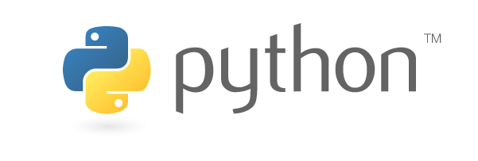

Introduction to
Apr 2016
Yoav Ram
Python Training
python.yoavram.com

Slide 2
What is Python?
Python is a
Widely used
High-level
General-purpose
Interpreted
Dynamic
Programming language
Wikipedia

Slide 3
Design emphasizes code readability
Uncluttered visual layout (whitespaces…)
English keywords used where other languages use punctuation (and, or, not…)
Aims for simplicity and generality
The Python mantra:
There should be one—and preferably only one—obvious way to do it
As opposed to the Perl and Ruby mantra:
There's more than one way to do it
Wikipedia

Slide 4
Example
C
Python
void foo(int x)
{
if (-1 < x && x < 1) {
bar();
baz();
} else {
qux(x);
foo(x - 1);
}
}
def foo(x):
if -1 < x < 1:
bar()
baz()
else:
qux(x)
foo(x - 1)

Slide 5
Multiple programming paradigms
Object-oriented programming
Imperative programming
Functional programming
Procedural programming
Event driven programming
Asynchronous programming
Wikipedia

Slide 6
Language features
Interpreted language
Dynamic type system (duck-typing)
Automatic memory management (GC)
Large and comprehensive standard library
Wikipedia

Slide 7
Multi-platform
Interpreters available for many operating systems
Code can be executed on a wide variety of systems
Code can be packaged into stand-alone executable programs
Wikipedia

Slide 8
Python culture
Free and open-source software
Community-based development model
Managed by the non-profit Python Software Foundation (PSF)
CPython is the reference implementation of Python
Other implementations:
IronPython for .NET framework, written in C#
Jython for Java framework
PyPy interpreter and JIT compiler, written in Python
MicroPython for microcontrollers and embedded systems
…
Wikipedia

Slide 9
History of Python
Developed in 1989-91 by Guido van Rossum in the Netherlands
Python 2.0 released Oct 2000
Many major new features:
cycle-detecting garbage collector
support for Unicode
shift to transparent and community-backed development
Python 3.0 released Dec 2008
major backwards-incompatible release
many of major features backported to Python 2.6 and 2.7
Python 3.5 released Sep 2015

Slide 10
Version history
Python 1.0 - January 1994
Python 1.5 - December 31, 1997
Python 1.6 - September 5, 2000
Python 2.0 - October 16, 2000
Python 2.1 - April 17, 2001
Python 2.2 - December 21, 2001
Python 2.3 - July 29, 2003
Python 2.4 - November 30, 2004
Python 2.5 - September 19, 2006
Python 2.6 - October 1, 2008
Python 2.7 - July 3, 2010
Python 3.0 - December 3, 2008
Python 3.1 - June 27, 2009
Python 3.2 - February 20, 2011
Python 3.3 - September 29, 2012
Python 3.4 - March 16, 2014
Python 3.5 - September 13, 2015

Slide 11
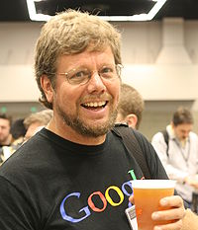
Guido van Rossum
Python's principal author
Still has a central role in deciding
the direction of Python development
Titled by the Python community: Benevolent Dictator for Life (BDFL)
Employed by Google 2005-2012
Spent half his time developing Python
Since 2013 works for Dropbox
Spends half his time developing Python…
Wikipedia
Homepage

Slide 12
Why Python?
I used Matlab. Now I use Python. by Steve Tjoa
Why use Python for scientific computing?

Slide 13
Python is Free

Slide 14
Gratis: Free as in Beer
Python is totally free
MATLAB is expensive
Individuals: $2,605
Academia: $625
Personal: $135
Student: $45-89
MathWorks Pricing

Slide 15
Libre: Free as in Speech
MATLAB source code is closed and proprietary
You cannot see the code
You cannot change the code
You can participate in the discussion as a client
Python source code is open
You can see, you can change, you can contribute code and documentation (python, numpy)
You can participate in the discussion as a peer (python, numpy)

Slide 16
Python is a general-purpose language

Slide 17
Python is used for:
Scientific computing
Enterprise software
Web design
Back-end
Front-end
Everything in between

Slide 18
Python is used at
Google, Rackspace, Microsoft, Intel, Walt Disney, MailChimp, twilio, Bank of America, Facebook, Instagram, HP, Linkedin, Elastic, Mozilla, YouTube, ILM, Thawte, CERN, Yahoo!, NASA, Trac, Civilization IV, reddit, LucasFilms, D-Link, Phillips, AstraZeneca,
https://us.pycon.org/2016/sponsors/
https://www.python.org/about/quotes/
https://en.wikipedia.org/wiki/Python_%28programming_language%29#Use
https://en.wikipedia.org/wiki/List_of_Python_software
https://www.python.org/about/success/

Slide 19
How Dropbox Did It and How Python Helped
Rian Hunter, a Dropbox Engineer presented at PyCon 2011:
99.9 % of code in Python.
Server backend, desktop client, website controller logic, API backend, and analytics.
Run on a single code base using Python: Windows, Mac, Linux using tools like PyObjs, WxPython, types, py2exe, py2app, PyWin32.
Python helped iterate fast through error cases they experienced on the wide variety of platforms they support.
Use C for inner loops - optimizing CPU is easy.
Custom memory allocator - optimizing memory is harder.
See more at highscalability

Slide 20
Success story: Philips
Semiconductor manufacturing facility in Fishkill, NY
In 1997 they started redesigning the system architecture
Python was suggested
Concern if a scripting language is suitable for the bulk of the code
Some favored significant portions of code in C++
Everybody seemed to have a preference that wasn't Python
After much discussion, Python prevailed
The project was a huge success
Rebuilt 8 years of software development effort in less <2 years with a smaller team
Success attributed largely to Python - it is very easy to develop code quickly:
Python requires less supporting code – less boilerplate
Python speeds the development cycle – no compilation
Python facilitates debugging – even without using debugger
Later on, moving the system from OS/2 to Linux required almost no effort
Michael Muller, https://www.python.org/about/success/philips/

Slide 21
Python is portable
More or less same code runs on Windows, Linux, OSX, and any platform with a Python interpreter
Python for "other" platforms

Slide 22
Python syntax is beautiful

Slide 23
Python syntax is beautiful
Once you get over the use of meaningful whitespace, you realize how much it makes sense.
Famous entrepreneur and investor Paul Graham:
You spend more time reading code than writing it.
You push blobs of source code around the way a sculptor does blobs of clay.
So a language that makes source code ugly is maddening to an exacting programmer, as clay full of lumps would be to a sculptor.
The Python Paradox, by Paul Graham

Slide 24
Python is inherently object-oriented

Slide 25
Almost everything is an object
strings, lists, dictionaries, tuples, functions, classes, and more
The implied usefulness is that these things each have their own members and methods that encapsulate its functionality and information
Strong polymorphism

Slide 26
Python is high level, easy to learn, and fast to develop
So is MATLAB

Slide 27
Python has many cool features
Stack overflow: Hidden features of Python

Slide 28
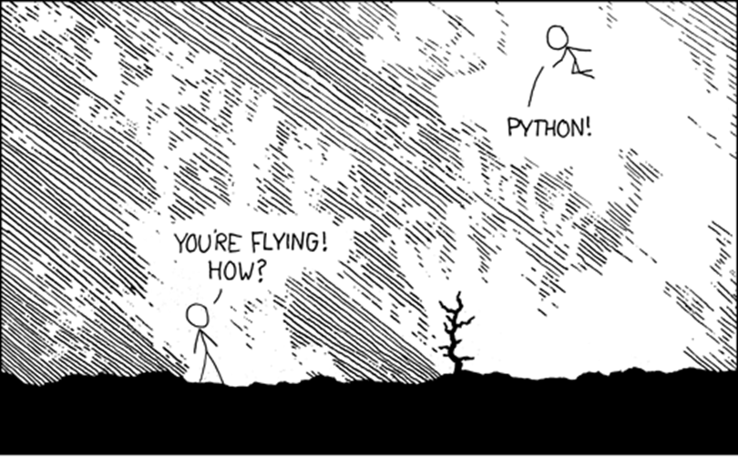
XKCD 353

Slide 29
Python is fast enough
Written in C (and some Fortran)
Easy to wrap more C
Easy to parallelize
Benchmark Game | NumFocus Benchmarks

Slide 30
Python is popular and has a great community

Slide 31
Great community
Programmers
Scientists
Mathematicians
Engineers

Slide 32
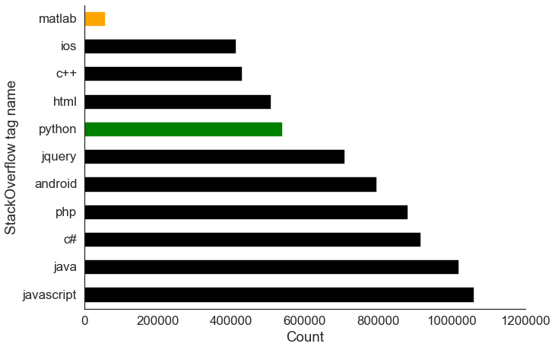
Easy to find help on the Internet
Python is 7th most popular tag on StackOverflow
MATLAB is 60th most popular tag on StackOverflow
stackoverflow.com/tags, Feb 2016

Slide 33
Active community
3rd most active repositories on GitHub after Java (incl. Android) and JavaScript (incl. node.js)
~27-fold more than MATLAB
As of Feb 2016
See breakdown at githut

Slide 34
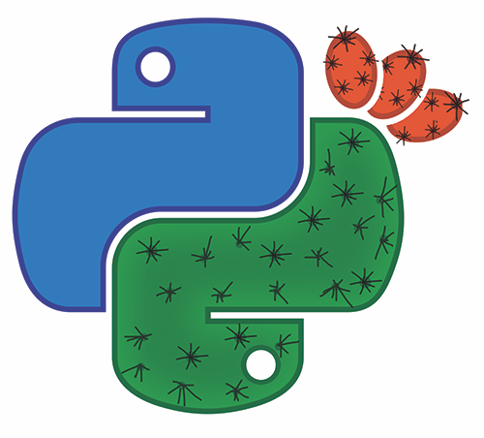
First PyCon in Israel!
Tel Aviv, Israel, May 2-3
Keynote by Travis Oliphant, creator of NumPy & SciPy.
Sponsored by RedHat, Cymmetria, AutoDesk, XtremIO, Cisco, Dropbox, SentinelOne, Cloudify, Adgorithms, PSF, applitools, HP
I’m giving a talk:
How to Study Evolution Using Scientific Python
http://il.pycon.org
pycon-israel@googlegroups.com

Slide 35
Python has great libraries

Slide 36
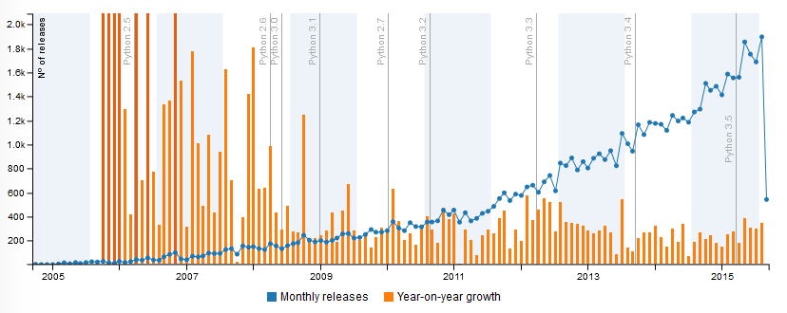
Many new libraries released every month
During 2015, > 1,500 new packages released every month to PyPI.
See more stats at PyGarden/stats.

Slide 37
Python can do nearly everything MATLAB can do
With libraries like NumPy, SciPy, Matplotlib, IPython, Scikit, and more

Slide 38
Demand & supply of Python programmers is high

Slide 39
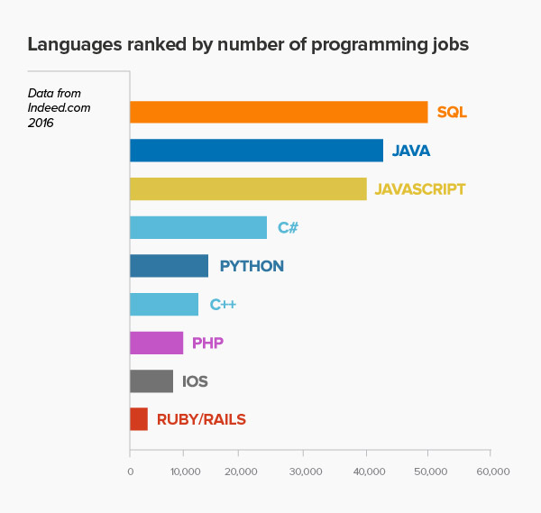
Coding Dojo

Slide 40
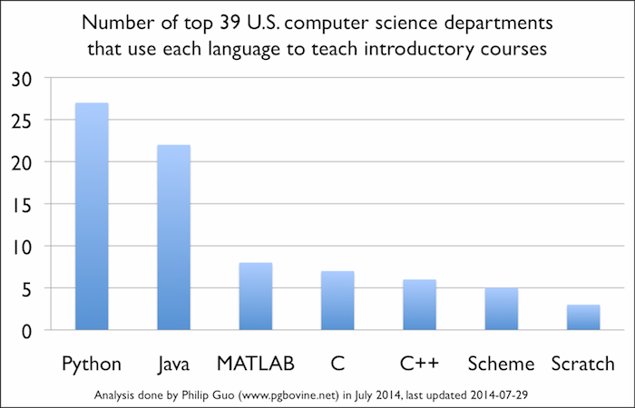
Phillip Gou @ CACM

Slide 41
First language at Israeli universities
TAU: CS & Engineering use Python
Technion: CS use C, some courses in Python
HUJI: CS & Humanities, use Python
BGU: CS use Java, Engineering use C

Slide 42
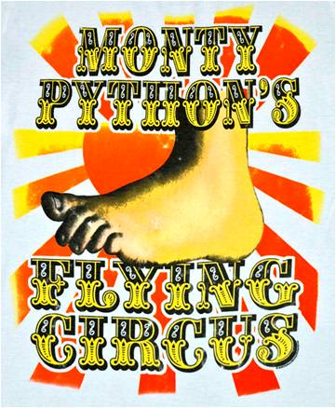
But why Python?
Guido was reading some Monty Python's Flying Circus sketches and thought Python would be a cool name
Python 2 FAQ

Slide 43
What is Python?
Python is
powerful... and fast
plays well with others
runs everywhere
is friendly & easy to learn
is Open
These are some of the reasons people who use Python would rather not use anything else
python.org/about

Slide 44
Yoav Ram
Python Training
python.yoavram.com

